Slide 1
Database Systems
Introduction to Databases and Data Warehouses
(Solutions to end-of-chapter exercises E8.1, E8.2, E8.3)

Slide 2
E8.1 ZAGI Retail Company
Consider the following, slightly modified, ZAGI Retail Company scenario. The ZAGI Retail Company wants to create analytical database to analyze sales.
The three available data sources are:
Source 1 The ZAGI Retail Company Sales Department Database, as shown below)
Source 2 The ZAGI Retail Company Facilities Department Database shown below
Source 3 A Customer Demographic Data external table shown below.

Slide 3
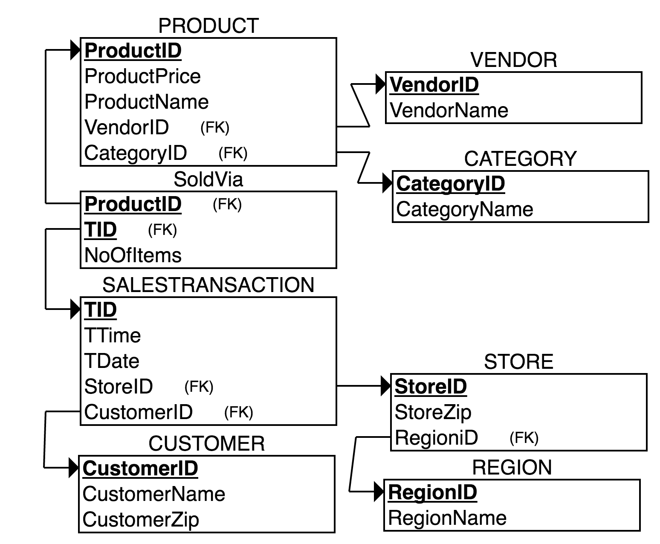
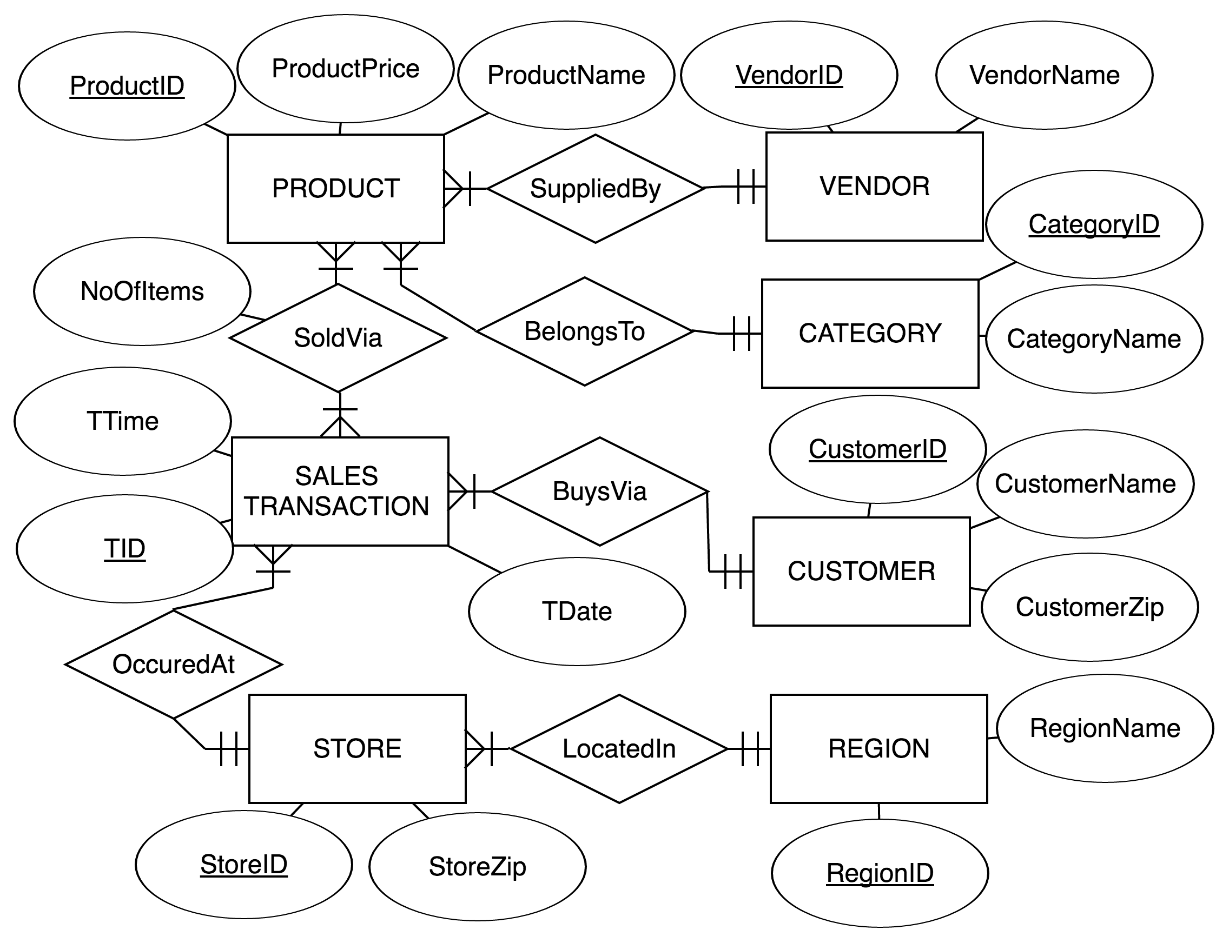
Source 1: ZAGI Sales Department

Slide 4
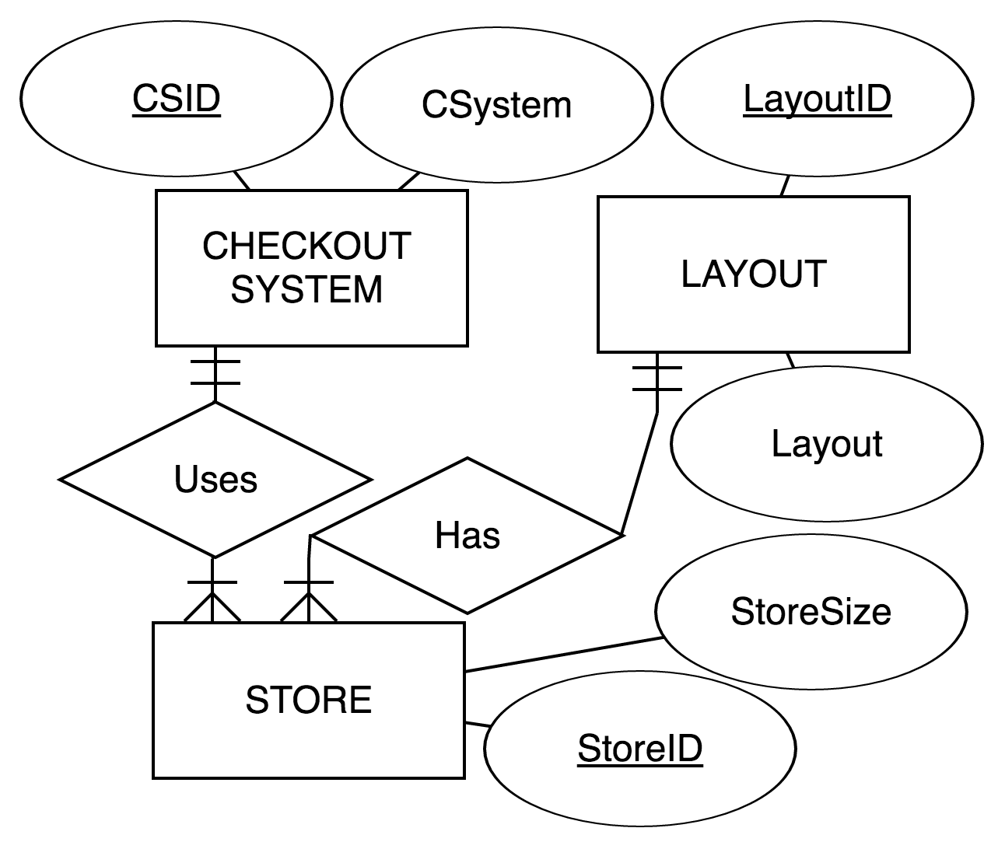
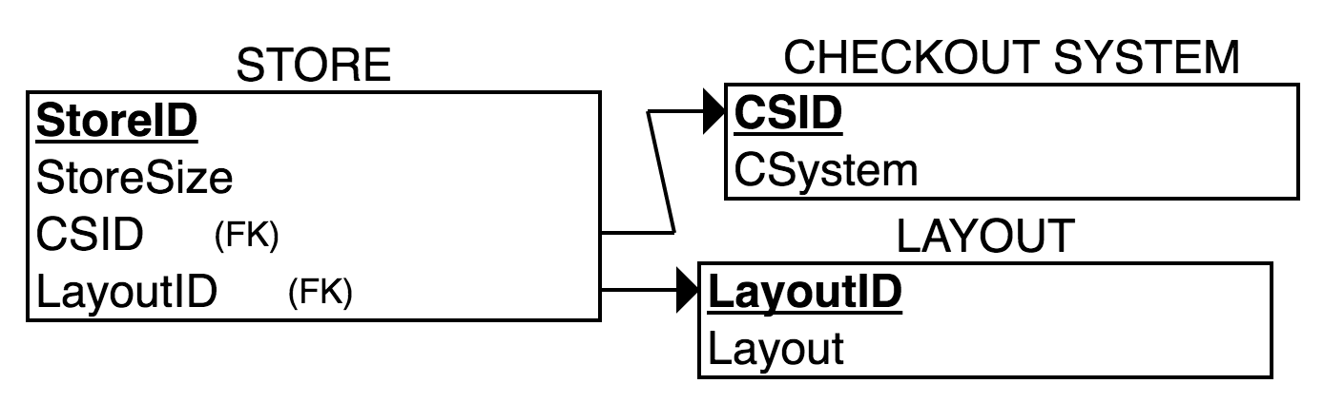
Source 2: ZAGI Facilities Department

Slide 5
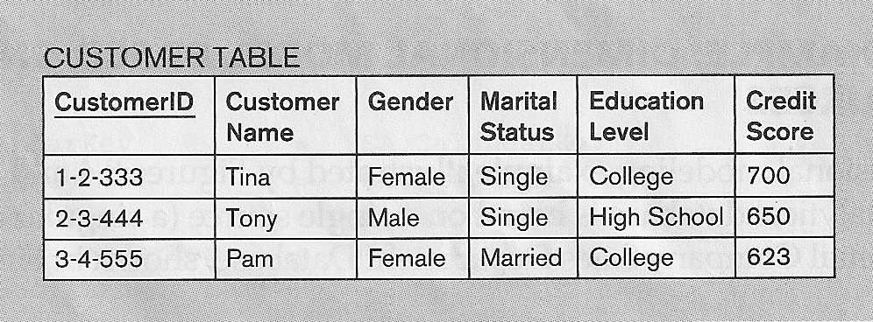
Source 3: Customer Demographic external table

Slide 6
E8.1 ZAGI Retail Company data warehouse
The data warehouse has to enable an analysis of sales dollar amounts and quantities by
date, including: full date, day of week, day of month, month quarter, year
time
product, including: product name and price, product category, product vendor
customer, including: customer name, zip, gender, marital status, education level, credit score
store, including: individual store, store size and store zip, store checkout system, store layout, store region.

Slide 7
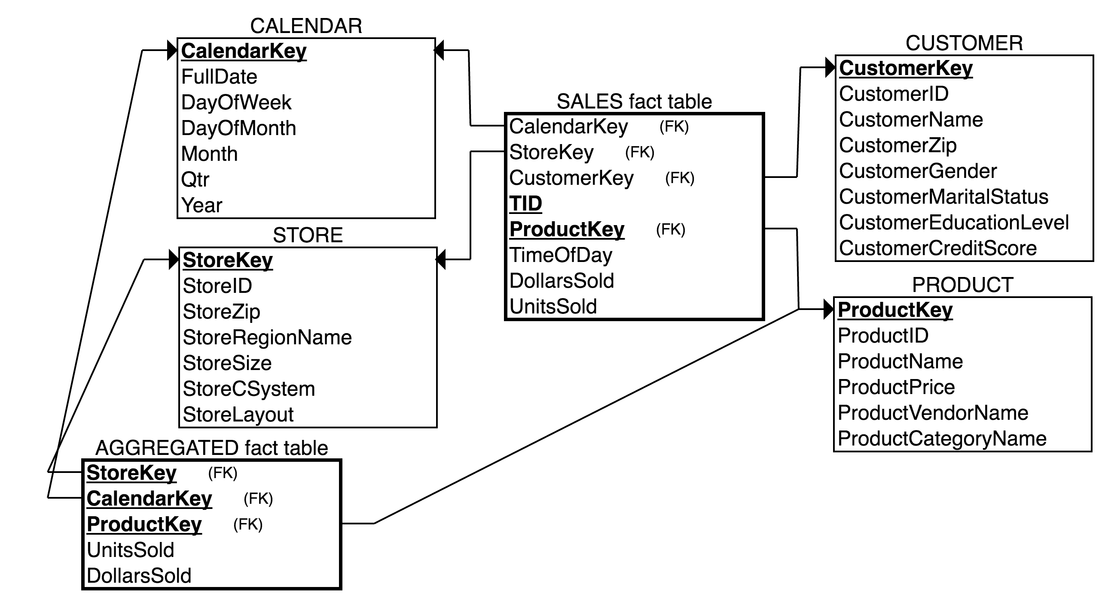
ZAGI Sales Dimensional DW model (star schema)

Slide 8
INSERT INTO Statements
INSERT INTO ZAGI_Dimensional.CALENDAR_D (FullDate, DayOfWeek, DayOfMonth, Month, Qtr, Year ) SELECT DISTINCT TDate as FullDate, DAYOFWEEK(tdate) AS DayOfWeek, dayofmonth(tdate) AS DayOfMonth, month(tdate) AS Month, quarter(tdate) AS Qtr, year(tdate) AS Year FROM SALESTRANSACTION;
INSERT INTO ZAGI_Dimensional.PRODUCT_D (ProductID, ProductName, ProductPrice, ProductVendorName, ProductCategoryName ) SELECT p.ProductID as ProductID, p.ProductName, p.ProductPrice, v.VendorName AS ProductVendorName, c.CategoryName AS ProductCategoryName FROM PRODUCT p, VENDOR v, CATEGORY c WHERE p.VendorID = v.VendorID AND p.CategoryID = c.CategoryID GROUP BY p.ProductID;
INSERT INTO ZAGI_Dimensional.STORE_D (StoreID, StoreZip, StoreRegionName, StoreSize, StoreCSystem, StoreLayout ) SELECT s.StoreID as StoreId, s.StoreZip AS StoreZip, r.RegionName AS StoreRegionName, s1.StoreSize AS StoreSize, cs.CSystem AS StoreCSystem, l.Layout AS StoreLayout FROM ZAGI_Sales_Dep.STORE s, ZAGI_Sales_Dep.REGION r, ZAGI_Facilities_Dep.STORE1 s1, ZAGI_Facilities_Dep.CHECKOUTSYSTEM cs, ZAGI_Facilities_Dep.LAYOUT l WHERE r.RegionID = s.RegionID AND s.StoreID=s1.StoreID AND s1.CSID = cs.CSID AND s1.LTID = l.LayoutID GROUP BY s.StoreID;

Slide 9
INSERT INTO ZAGI_Dimensional.CUSTOMER_D(CustomerID, CustomerName, CustomerZip, CustomerGender, CustomerMaritalStatus, CustomerEducationLevel, CustomerCreditScore )SELECT t1.customerid as CustomerId, t1.customername AS CustomerName, t1.customerzip AS CustomerZip, t2.gender AS CustomerGender, t2.maritalstatus AS CustomerMaritalStatus, t2.educationlevel AS CustomerEducationLevel, t2.creditscore AS CustomerCreditScore FROM ZAGI_Sales_Dep.CUSTOMER AS t1, ZAGI_Customer_Table.CUSTOMER_TABLE AS t2 WHERE t1.CustomerID = t2.CustomerID;
CREATE VIEW `SALES_FACT_VIEW` AS SELECT st.TDate, st.StoreID, sv.ProductID, st.CustomerID, sv.TID AS TID, st.TTime AS TimeOfDay, p.ProductPrice*sv.NoOfItems AS DollarsSold, sv.NoOfItems AS UnitsSold FROM ZAGI_Sales_Dep.SOLDVIA AS sv, ZAGI_Sales_Dep.PRODUCT AS p, ZAGI_Sales_Dep.SALESTRANSACTION AS st WHERE sv.ProductID = p.ProductID AND sv.TID = st.TID;
INSERT INTO ZAGI_Dimensional.SALES_FACT (CalendarKey, StoreKey, ProductKey, CustomerKey, TID, TimeOfDay, DollarsSold, UnitsSold ) SELECT CA.CalendarKey, S.StoreKey, P.ProductKey, CU.CustomerKey, SFV.TID, SFV.TimeOfDay, SFV.DollarsSold, SFV.UnitsSold FROM ZAGI_Sales_Dep.SALES_FACT_VIEW AS SFV, ZAGI_Dimensional.CALENDAR_D AS CA, ZAGI_Dimensional.PRODUCT_D AS P, ZAGI_Dimensional.STORE_D as S, ZAGI_Dimensional.CUSTOMER_D AS CU WHERE CA.FullDate = SFV.TDate AND S.StoreID = SFV.StoreID AND P.ProductID = SFV.ProductID AND CU.CustomerID = SFV.CustomerID;

Slide 10
E8.1b, E8.1c Aggregated Fact Table
A dimensional model above contains an aggregated fact table, which shows a summary of units sold and dollars sold for daily purchases of each product in each store. It is populated as shown below.
INSERT INTO ZAGI_Dimensional.AGGREGATED_FACT (CalendarKey, StoreKey, ProductKey, DollarsSold, UnitsSold)
SELECT SF.CalendarKey, SF.StoreKey, SF.ProductKey, SUM(DollarsSold), SUM(UnitsSold)
FROM ZAGI_Dimensional.SALES_FACT SF
GROUP BY CalendarKey, StoreKey, ProductKey;

Slide 11
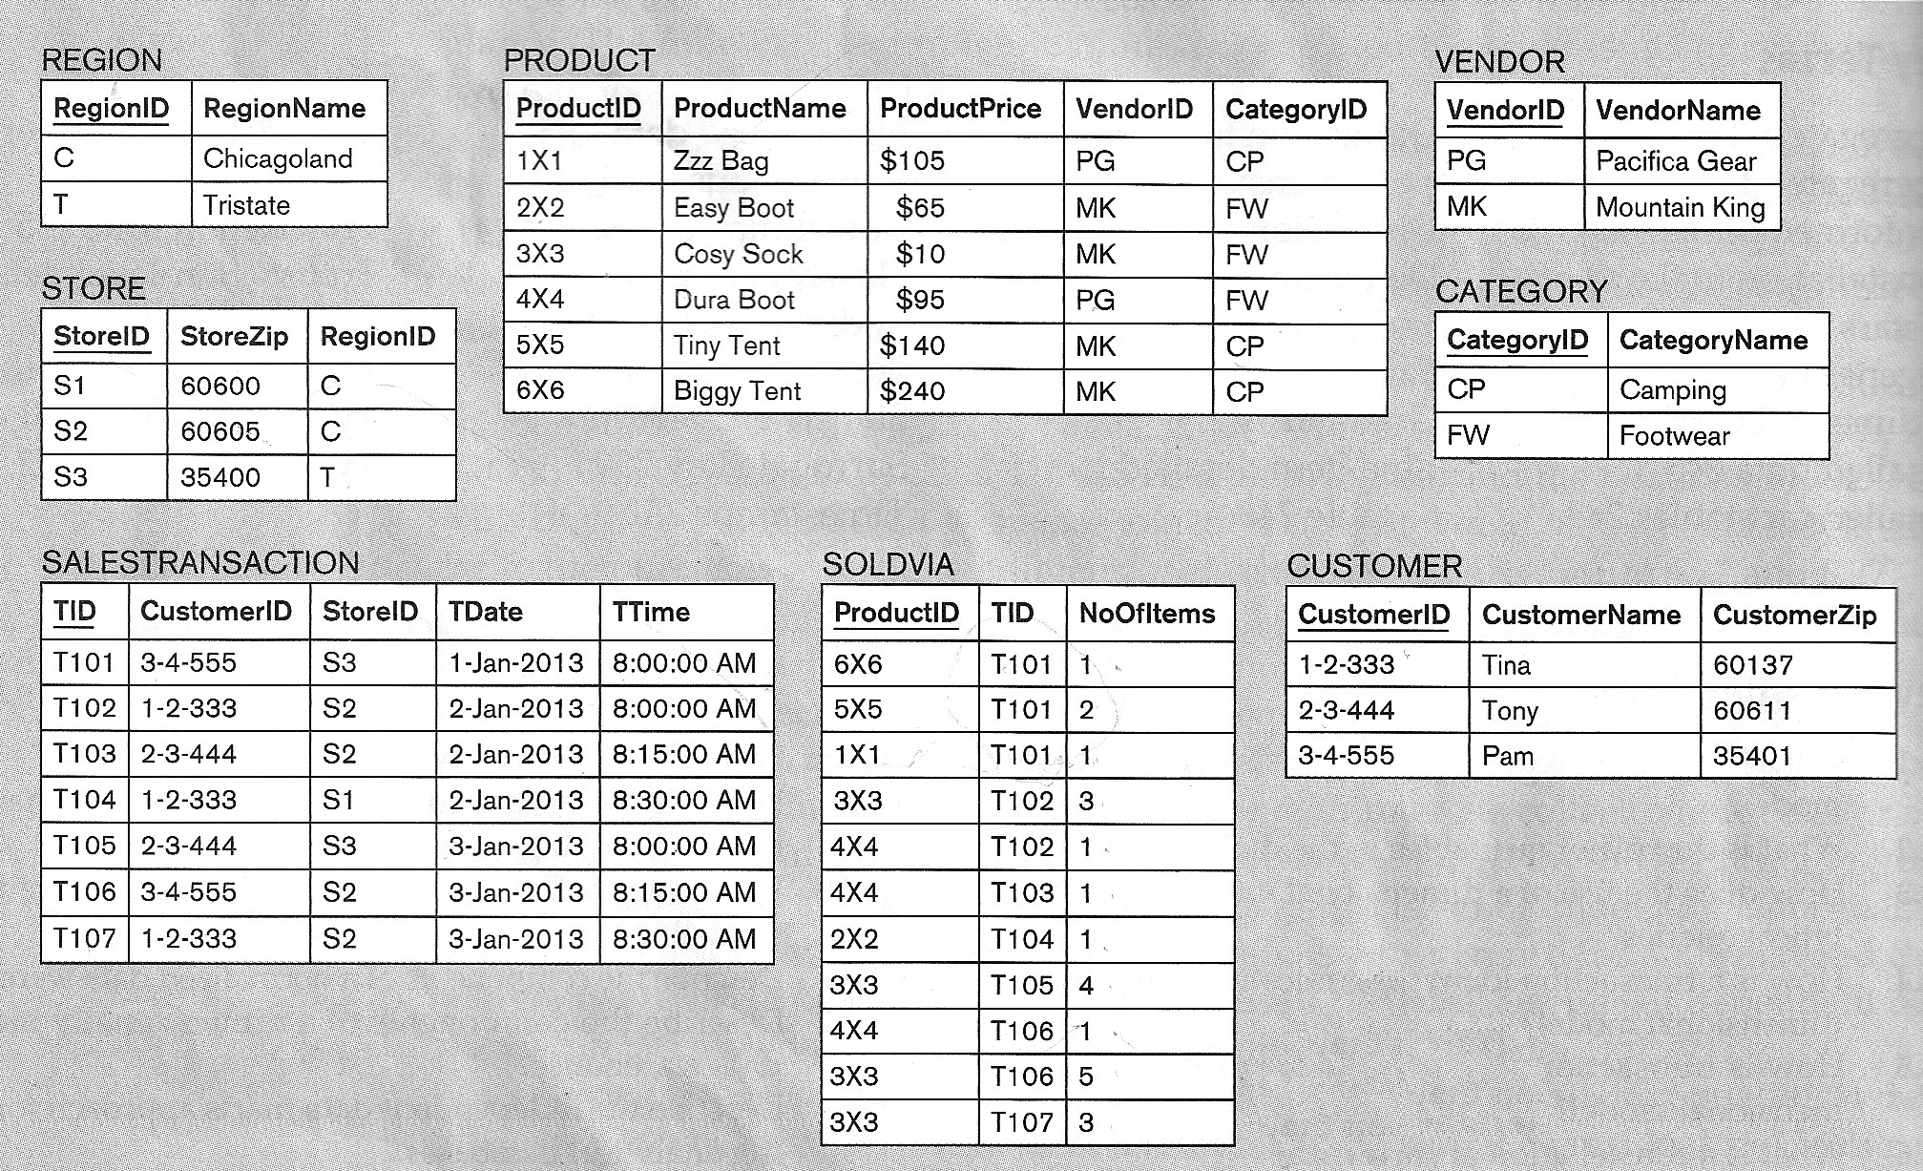
Source 1: ZAGI Sales Department data

Slide 12
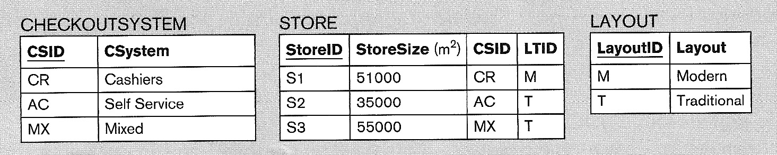
Source 2: ZAGI Facilities Department data

Slide 13
Source 3: Customer Demographic data external table

Slide 14
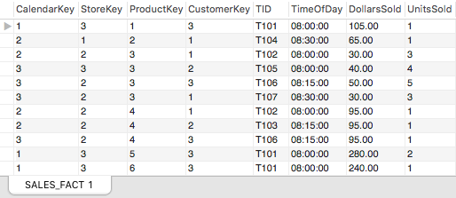
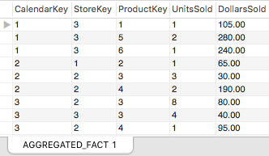
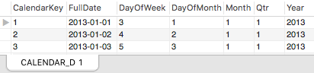
ZAGI Sales Dimensional DW: fact tables populated with data, Calendar dimension

Slide 15
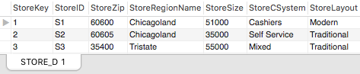
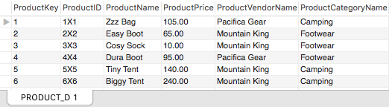
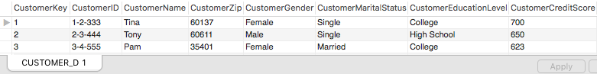
ZAGI Sales Dimensional DW: Store, Product and Customer Dimensions Populated with data

Slide 16
E8.2 City Police Department
Consider the following scenario involving the City Police Department. The City Police Department wants to create an analytical database to analyze its ticket revenue.
The two available data sources, Source 1 and Source 2, are described below.
Source 1 The City Police Department maintains the Ticketed Violations Database, shown in Figure below.
Source 2 The Department of Motor Vehicles (DMV) maintains the Vehicle Registration Table, shown in Figure below

Slide 17
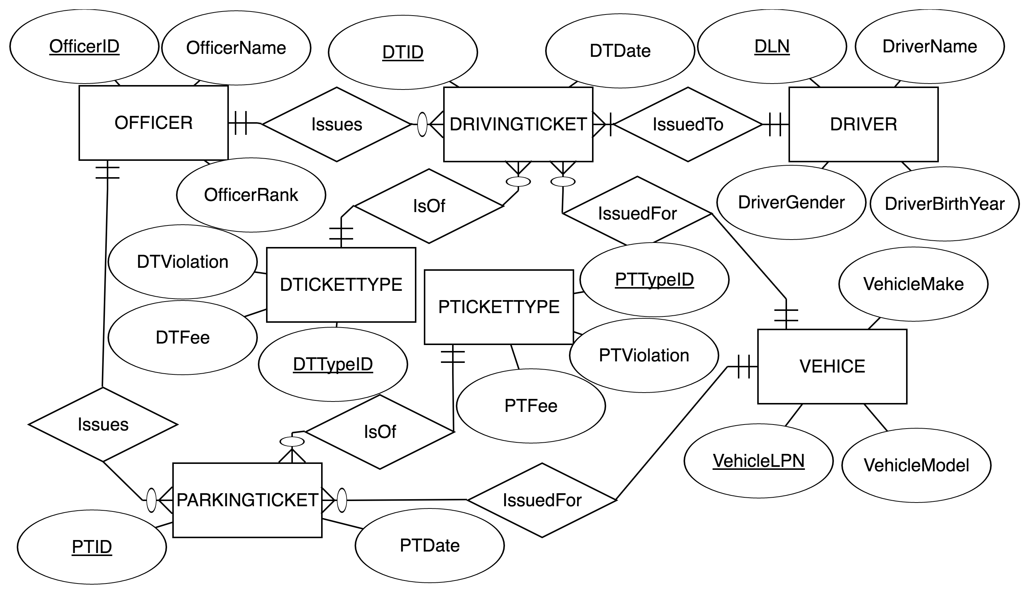
Source 1: CPD Ticketed Violations

Slide 18
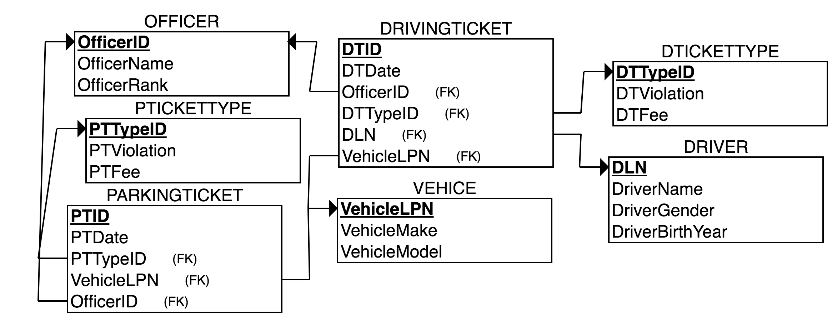
Source 1: CPD Ticketed Violations

Slide 19
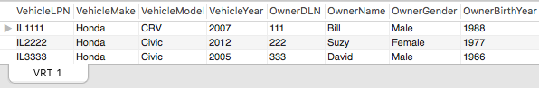
Source 2: DMV Vehicle Registration Table

Slide 20
E8.2 Ticket Revenue Data Warehouse
The data warehouse has to enable an analysis of ticket revenues by:
date, including: full date day of week, day of month, month, quarter, year
officer, including: officer ID, officer name, officer rank
payer of the ticket, including: payer DLN, payer name, payer gender, payer birth year
vehicle, including: vehicle LPN, vehicle make, vehicle model, vehicle year, vehicle owner DLN, vehicle owner name, vehicle owner gender, vehicle owner birth year
ticket type, including: ticket category (driving or parking), ticket violation, ticket fee

Slide 21
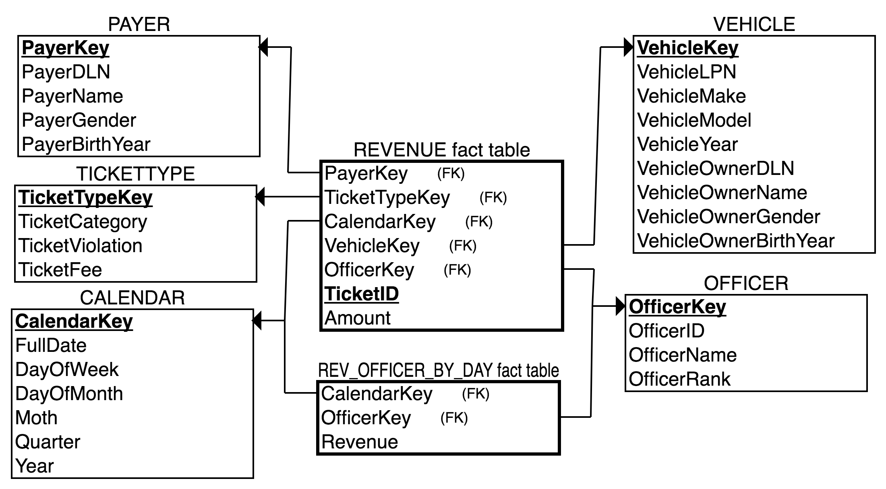
Ticket Revenue Dimensional DW model (star schema)

Slide 22
INSERT INTO statements
INSERT INTO CPD_Ticket_Revenue.CALENDAR (FullDate, DayOfWeek, DayOfMonth, Month, Quarter, Year ) SELECT DISTINCT DTDate as FullDate, DAYOFWEEK(DTDate) AS DayOfWeek, dayofmonth(DTDate) AS DayOfMonth, month(DTDate) AS Month, quarter(DTDate) AS Qtr, year(DTDate) AS Year FROM CPD_Ticketed_Violations.DRIVINGTICKET UNION SELECT DISTINCT PTDate as FullDate, DAYOFWEEK(PTDate) AS DayOfWeek, dayofmonth(PTDate) AS DayOfMonth, month(PTDate) AS Month, quarter(PTDate) AS Quarter, year(PTDate) AS Year FROM CPD_Ticketed_Violations.PARKINGTICKET;
INSERT INTO CPD_Ticket_Revenue.OFFICER (OfficerID, OfficerName, OfficerRank) SELECT OfficerID, OfficerName, OfficerRank FROM CPD_Ticketed_Violations.OFFICER;
INSERT INTO CPD_Ticket_Revenue.TICKETTYPE (TicketCategory, TicketViolation, TicketFee) SELECT * FROM CPD_Ticketed_Violations.DTICKETTYPE UNION SELECT * FROM CPD_Ticketed_Violations.PTICKETTYPE;
INSERT INTO CPD_Ticket_Revenue.PAYER (PayerDLN, PayerName, PayerGender, PayerBirthYear)SELECT * FROM CPD_Ticketed_Violations.DRIVER;
INSERT INTO CPD_Ticket_Revenue.VEHICLE (VehicleLPN, VehicleMake, VehicleModel, VehicleYear, VehicleOwnerDLN, VehicleOwnerName, VehicleOwnerGender, VehicleOwnerBirthYear) SELECT v1.VehicleLPN, v2.VehicleMake, v2.VehicleModel, v2.VehicleYear, v2.OwnerDLN, v2.OwnerName, v2.OwnerGender, OwnerBirthYear FROM CPD_Ticketed_Violations.VEHICLE AS v1, CPD_Vehicle_Registration_Table.VRT AS v2 WHERE v1.VehicleLPN = v2.VehicleLPN;

Slide 23
INSERT INTO CPD_Ticket_Revenue.REVENUE_FACT (CalendarKey, OfficerKey, PayerKey, VehicleKey, TicketTypeKey, TicketID, Amount)SELECT C.CalendarKey, O.OfficerKey, P.PayerKey, V.VehicleKey, TT.TicketTypeKey, dt.DTID AS TID, dtt.DTFee AS Amount FROM CPD_Ticketed_Violations.DRIVINGTICKET dt, CPD_Ticketed_Violations.DTICKETTYPE dtt, CPD_Ticket_Revenue.CALENDAR as C, CPD_Ticket_Revenue.PAYER as P, CPD_Ticket_Revenue.VEHICLE as V, CPD_Ticket_Revenue.OFFICER as O, CPD_Ticket_Revenue.TICKETTYPE AS TT WHERE dt.DTTypeID = dtt.DTTypeID and dt.OfficerID = O.OfficerID and dt.DLN = P.PayerDLN and dt.VehicleLPN = V.VehicleLPN and dt.DTTypeID = TT.TicketCategory and C.FullDate = dt.DTDateGROUP BY TID UNION SELECT C.CalendarKey, O.OfficerKey, P.PayerKey, V.VehicleKey, TT.TicketTypeKey, pt.PTID AS TID, ptt.DTFee AS Amount FROM CPD_Ticketed_Violations.PARKINGTICKET pt, CPD_Vehicle_Registration_Table.VRT vr, CPD_Ticketed_Violations.PTICKETTYPE ptt, CPD_Ticket_Revenue.CALENDAR as C, CPD_Ticket_Revenue.PAYER as P, CPD_Ticket_Revenue.VEHICLE as V, CPD_Ticket_Revenue.OFFICER as O, CPD_Ticket_Revenue.TICKETTYPE AS TT WHERE pt.PTTypeID = ptt.PTTypeID and pt.OfficerID = O.OfficerID and vr.OwnerDLN = P.PayerDLN and pt.VehicleLPN = V.VehicleLPN and pt.PTTypeID = TT.TicketCategory and C.FullDate = pt.PTDateGROUP BY TID;

Slide 24
E8.2b,c Aggregated fact table
A dimensional model above contains an aggregated fact table, which shows a summary of daily revenue amount for each officer. It is populated as shown below.
INSERT INTO CPD_Ticket_Revenue.REV_OFFICER_BY_DAY (CalendarKey, OfficerKey, Revenue)
SELECT CalendarKey, OfficerKey, SUM(Amount)
FROM CPD_Ticket_Revenue.REVENUE_FACT
GROUP BY CalendarKey, OfficerKey;

Slide 25
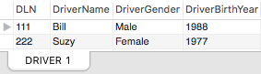
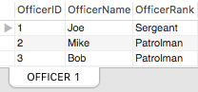
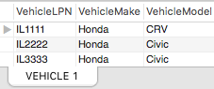
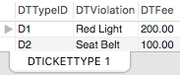
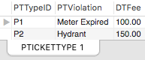
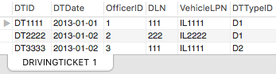
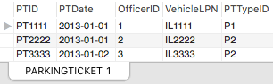
Sources 1: CPD Ticketed Violations data

Slide 26
Source 2: DMV Vehicle Registration table

Slide 27
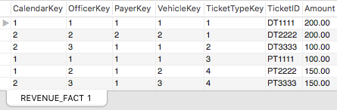
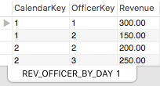
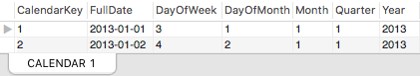
Ticket Revenue DW: Fact Tables populated with data, Calendar dimension

Slide 28
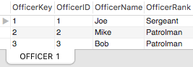
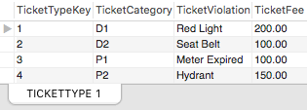
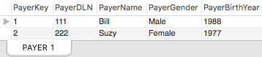
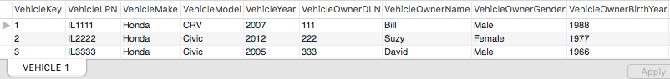
Ticket Revenue DW: Payer, Vehicle, Officer and TicketType Dimensions Populated with Data

Slide 29
E8.3 Big Z Inc. Automotive Products
Consider the following scenario involving Big Z Inc., an automotive products wholesaler analytical database Big Z Inc. wants to create the (data warehouse) to analyze its order quantities. The two available data sources, Source 1 and Source 2, are described below.
The three available data sources are:
Source 1 The Big Z Inc. Human Resources Department Table, shown below.
Source 2 The Big Z Inc. Orders Database, shown in Figure bellow.

Slide 30
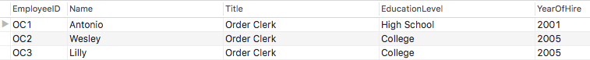
Source 1: HR Department table

Slide 31
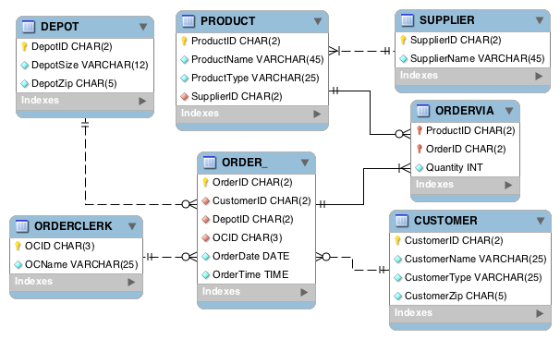
Source 2: Big Z Orders database

Slide 32
E8.3 Dimensional Warehouse
The data warehouse has to enable an analysis of order quantities by:
date, including: full date, day of week, day of month, month, quarter, year
time
product, including product ID, product name, product type, product supplier name
customer, including: customer ID, customer name, customer type, customer zip
depot, including depot ID, depot size, depot zip
order clerk, including: order clerk id, order clerk name, order clerk title, order clerk education level, order clerk year of hire
Based on the sources and requirements listed above, create a dimensional model that will be used for the dimensionally modeled data warehouse for Big Z Inc.

Slide 33
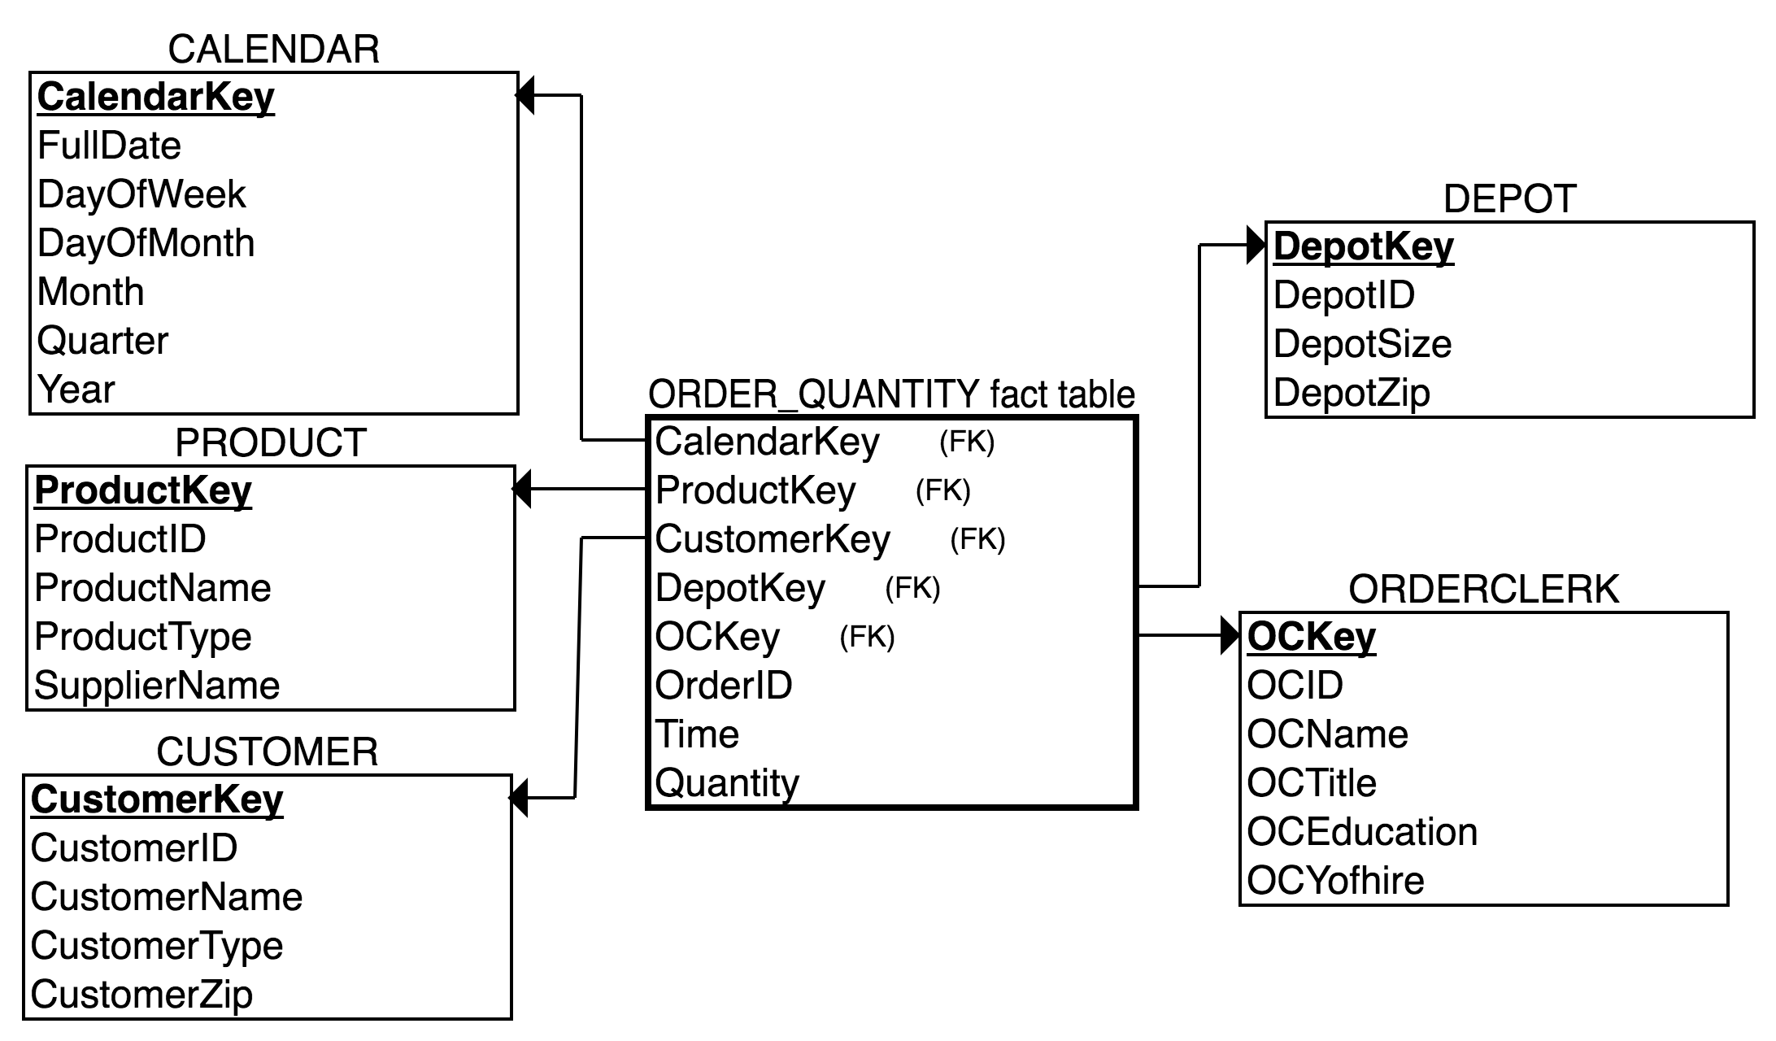
Big Z Order Quantities Dimensional DW model (star schema)

Slide 34
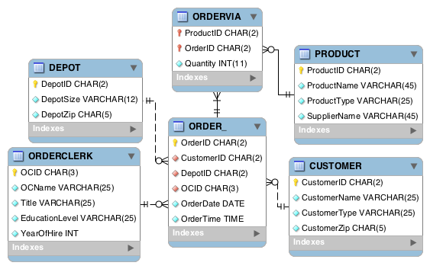
Big Z Orders Quantities Normalized schema

Slide 35
E8.3 INSERT INTO Statements
INSERT INTO BigZ_Dimensional.CALENDAR (FullDate, DayOfWeek, DayOfMonth, MONTH, Quarter, YEAR)SELECT DISTINCT OrderDate AS FullDate, DAYOFWEEK(OrderDate) AS DayOfWeek, dayofmonth(OrderDate) AS DayOfMonth, month(OrderDate) AS MONTH, quarter(OrderDate) AS Qtr, year(OrderDate) AS YEAR FROM BigZ_Orders.ORDER_;
INSERT INTO BigZ_Dimensional.CUSTOMER (CustomerID, CustomerName, CustomerType, CustomerZip) SELECT * FROM BigZ_Orders.CUSTOMER;
INSERT INTO BigZ_Dimensional.DEPOT (DepotID, DepotSize, DepotZip)SELECT * FROM BigZ_Orders.DEPOT;
INSERT INTO BigZ_Dimensional.ORDERCLERK (OCID, OCName, OCTitle, OCEducation, OCYofhire) SELECT oc.OCID, oc.OCName, hr.Title, hr.EducationLevel, hr.YearOfHire FROM BigZ_Orders.ORDERCLERK AS oc, BigZ_HR_Table.HRDEPARTMENT AS hr WHERE oc.OCID = hr.EmployeeID;
INSERT INTO BigZ_Dimensional.PRODUCT (ProductID, ProductName, ProductType, SupplierName)SELECT p.ProductID, p.ProductName, p.ProductType, s.SupplierNameFROM BigZ_Orders.PRODUCT AS p, BigZ_Orders.SUPPLIER AS s WHERE p.SupplierID = s.SupplierID;

Slide 36
INSERT INTO BigZ_Dimensional.ORDER_QUANTITY_FACT (CalendarKey, CustomerKey, DepotKey, OrderClerkKey, ProductKey, OrderID, TIME, Quantity) SELECT C.CalendarKey, CU.CustomerKey, D.DepotKey, OC.OCKey, P.ProductKey, OV.OrderID, O.OrderTime, sum(OV.Quantity) FROM BigZ_Dimensional.CALENDAR AS C, BigZ_Dimensional.CUSTOMER AS CU, BigZ_Dimensional.Depot AS D, BigZ_Dimensional.ORDERCLERK AS OC, BigZ_Dimensional.PRODUCT AS P, BigZ_Orders.ORDER_ AS O, BigZ_Orders.ORDERVIA AS OV WHERE O.OrderDate = C.FullDate AND O.CustomerID = CU.CustomerID AND O.DepotID = D.DepotID AND O.OCID = OC.OCID AND OV.ProductID = P.ProductID AND OV.OrderID = O.OrderIDGROUP BY OV.OrderID, OV.ProductID;
INSERT INTO BigZ_Normalized.ORDERCLERK (OCID, OCName, Title, EducationLevel, YearOfHire) SELECT HR.EmployeeID as OCID, HR.Name as OCName, HR.Title, HR.EducationLevel, HR.YearOfHire FROM BigZ_HR_Table.HRDEPARTMENT HR, BigZ_Orders.ORDERCLERK OC WHERE HR.EmployeeID = OC.OCID;
INSERT INTO BigZ_Normalized.CUSTOMER SELECT *FROM BigZ_Orders.CUSTOMER;
INSERT INTO BigZ_Normalized.DEPOT SELECT *FROM BigZ_Orders.DEPOT;
INSERT INTO BigZ_Normalized.PRODUCT SELECT p.ProductID, p.ProductName, p.ProductType, s.SupplierName FROM BigZ_Orders.PRODUCT AS p, BigZ_Orders.SUPPLIER AS s WHERE p.SupplierID = s.SupplierID;
INSERT INTO BigZ_Normalized.ORDER_SELECT * FROM BigZ_Orders.ORDER_;
INSERT INTO BigZ_Normalized.ORDERVIA SELECT * FROM BigZ_Orders.ORDERVIA;

Slide 37
Source 1: HR Department table

Slide 38
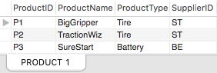
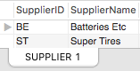
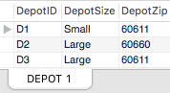
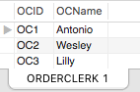
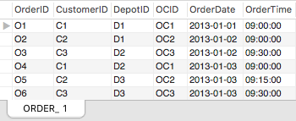
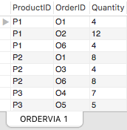
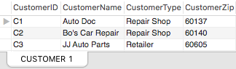
Source 2: Big Z Orders Database

Slide 39
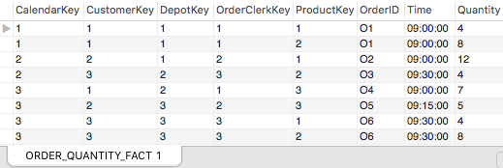
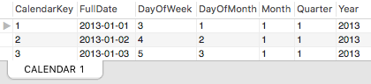
E8.3 Dimensional DW: Fact Table populated with data, Calendar dimension

Slide 40
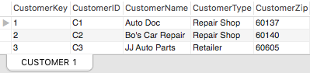
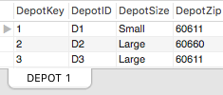
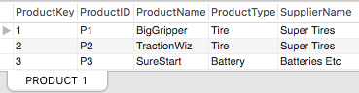
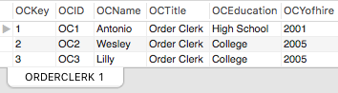
E8.3 Dimensional DW: Customer, Depot, Order Clerk and Product dimensions with data

Slide 41
References:
Jukic N., Vrbsky S., Nestorov S. “Database Systems. Introduction to Databases and Data Warehouses”. Pearson Education Inc., 2014.

